Slide 1
CLOUD COMPUTING UNIT – I
Introduction:
Business and IT perspective,
Cloud and virtualization,
Cloud services requirements,
cloud and dynamic infrastructure,
cloud computing characteristics,
cloud adoption.
Cloud Deployment models :
Cloud characteristics,
Measured Service,
Cloud deployment models,
security in a public cloud,
public verses private clouds,
cloud infrastructure self-service.

Slide 2

What is Computing ?
The use of a computer to process data or perform calculations.

Slide 3
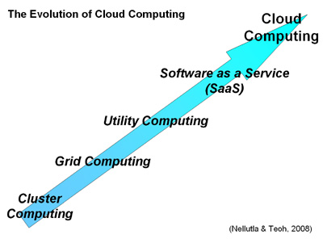
Computing Evolution

Slide 4
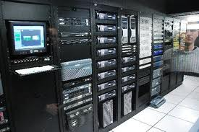
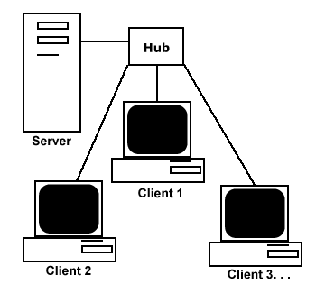
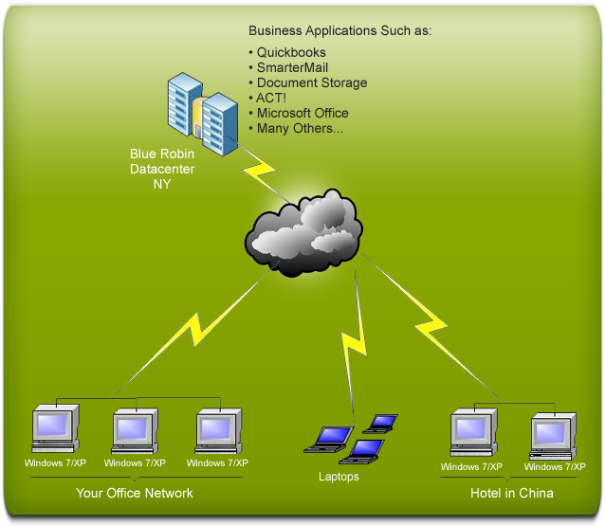
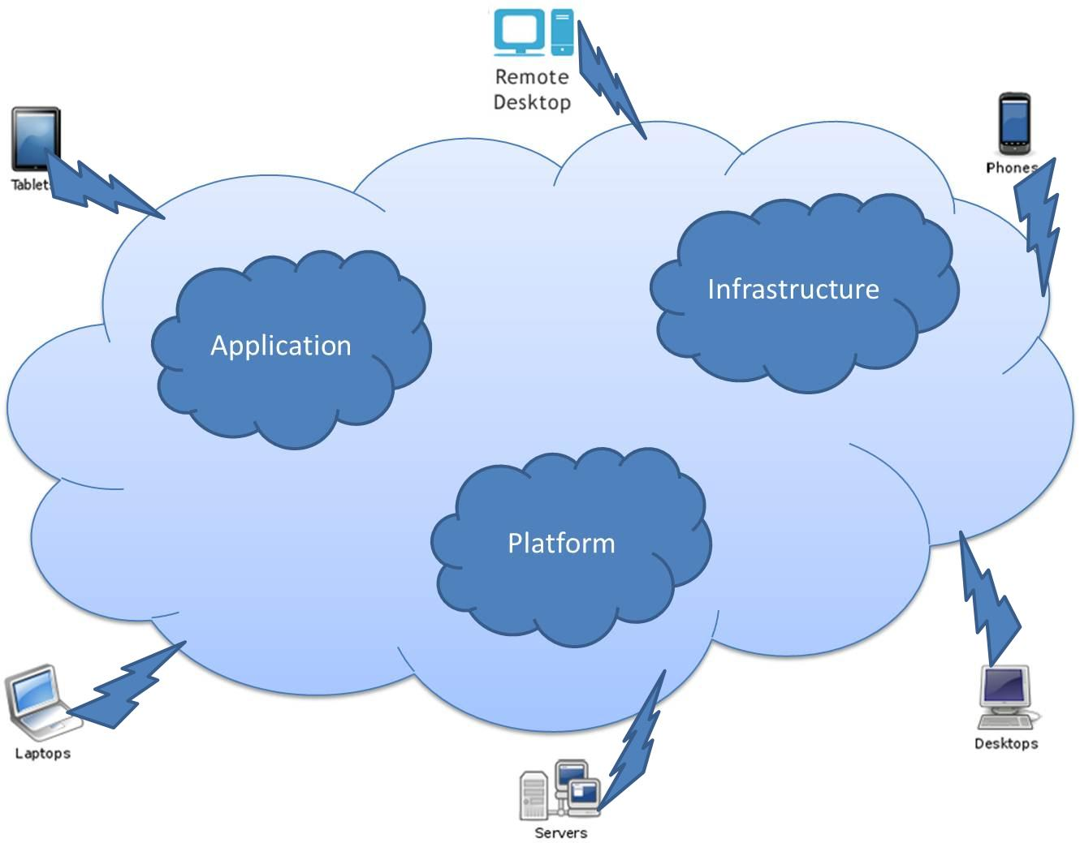
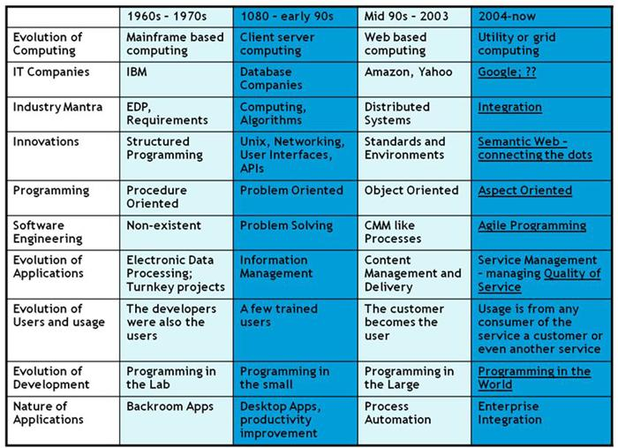

Slide 5
Main Frame Computers
Computers that can support thousands of applications and input/output devices to simultaneously serve thousands of users. (e.g:homeshop18, flipkart, amazon etc)
A mainframe is the central data repository, or hub, in a corporation’s data processing center, linked to users through less powerful devices such as workstations, terminals or media devices.
Can run multiple, but isolated operating systems concurrently.
Centralized control of resources.

Slide 6
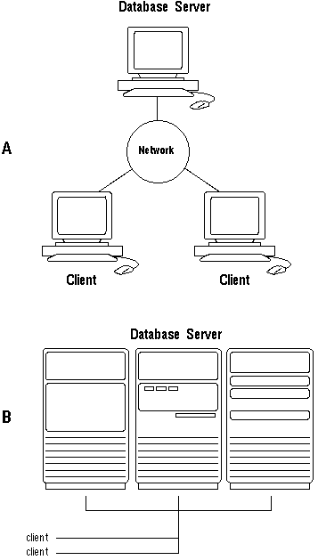
Client Server Architecture
Client-server architecture (client/server) is a network architecture in which each computer or process on the network is either a client or a server.
Servers are powerful computers or processes dedicated to managing disk drives (file servers), printers (print servers), or network traffic (network servers).

Slide 7
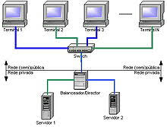
Cluster computing
In cluster computing, a group of similar computers is hooked up locally to operate as a single compute.
This facility utilized for load balance of servers.
Main advantages of this computer technology is distributed the load of server among the each servers of computer.

Slide 8
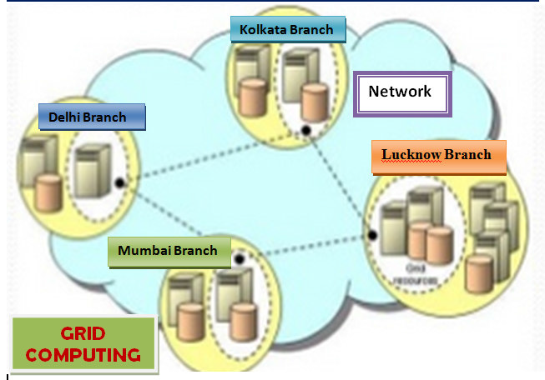
Grid Computing
Grid computing is the collection computers resources from multiple locations to reach a common goal.
Benefits of grid computing are Increase access to data and collaboration.
Join data and distribute it globally.
Workload balance, data security etc.

Slide 9
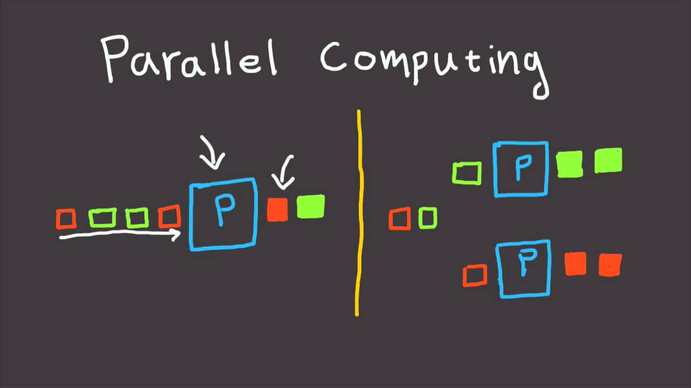
Parallel computing
Parallel computing is a type of computation in which many calculations or the execution of processes are carried out simultaneously.
Large problems can often be divided into smaller ones, which can then be solved at the same time.

Slide 10
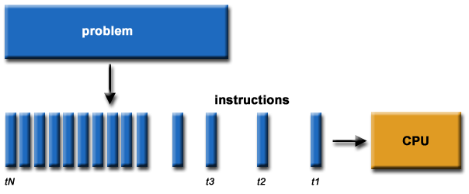
Traditionally, software has been written for serial computation:
To be run on a single computer having a single Central Processing Unit (CPU);
A problem is broken into a discrete series of instructions.
Instructions are executed one after another.
Only one instruction may execute at any moment in time.

Slide 11
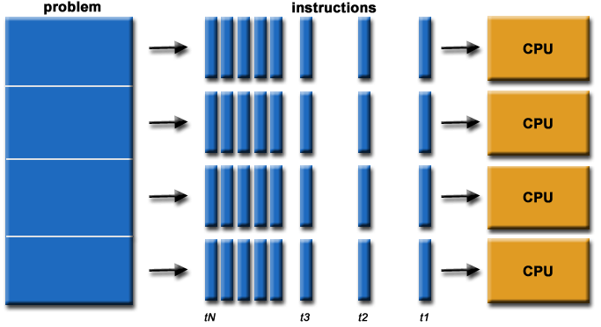
In the simplest sense, parallel computing is the simultaneous use of multiple compute resources to solve a computational problem.
To be run using multiple CPUs
A problem is broken into discrete parts that can be solved concurrently
Each part is further broken down to a series of instructions
Instructions from each part execute simultaneously on different CPUs

Slide 12
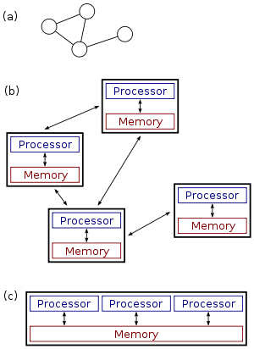
Distributed computing
Distributed computing is a field of computer science that studies distributed systems.
A distributed system is a model in which components located on networked computers communicate and coordinate their actions by passing messages.
The components interact with each other in order to achieve a common goal.

Slide 13




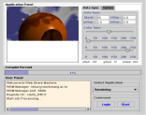

Agent
Agent
Cooperation
Agent
Cooperation
Distribution
Distribution
Cooperation
Distribution
Internet
Agent
Subscription
Distribution
Job Request
Resource
Management
Large-scale
Application

Slide 14
Utility computing
Utility computing, or The Computer Utility, is a service provisioning model in which a service provider makes computing resources and infrastructure management available to the customer as needed, and charges them for specific usage rather than a flat rate.

Slide 15
Cloud Computing
Cloud computing is an emerging computing technology that uses internet and central remote servers to maintain data and application.

Slide 16
Cloud Computing is a general term used to describe a new class of network based computing that takes place over the Internet,
basically a step on from Utility Computing
a collection/group of integrated and networked hardware, software and Internet infrastructure (called a platform).
Using the Internet for communication and transport provides hardware, software and networking services to clients
These platforms hide the complexity and details of the underlying infrastructure from users and applications by providing very simple graphical interface or API (Applications Programming Interface).

Slide 17
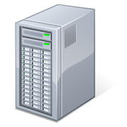
What is Cloud Computing
Applications
Services
Shared pool of configurable computing resources
On-demand network access
Provisioned by the Service Provider
Computer Network
Storage (Database)
SERvers
Adopted from: Effectively and Securely Using the Cloud Computing Paradigm by peter Mell, Tim Grance
Notes:
Cloud computing is a model for enabling convenient, on-demand network access to a shared pool of configurable computing resources (e.g., networks, servers, storage, applications, and services) that can be rapidly provisioned and released with minimal management effort or service provider interaction.
cloud computing customers do not own the physical infrastructure.
Cloud computing users avoid capital expenditure (CapEx) on hardware, software, and services when they pay a provider only for what they use.
Low shared infrastructure and costs, low management overhead, and immediate access to a broad range of applications

Slide 18
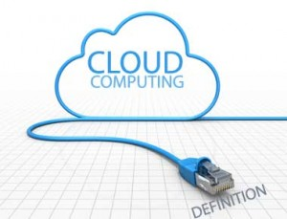
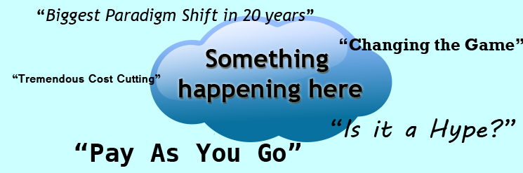
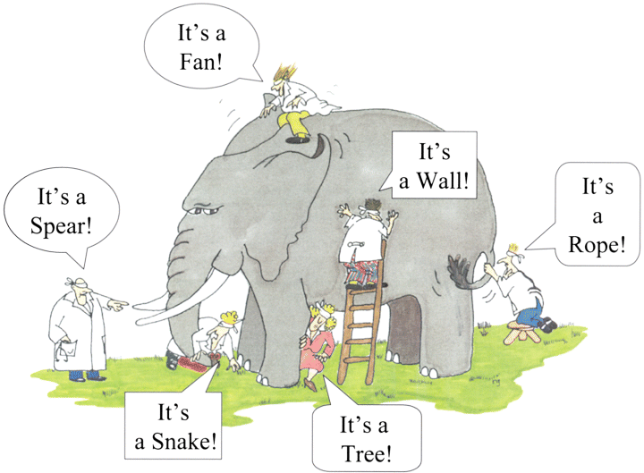
Cloud Computing
Different Users - Different Perspectives

Slide 19
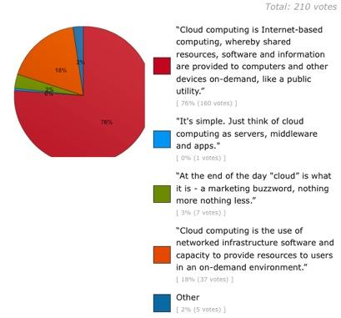
Cloud Definition - Twitter Poll Results

Slide 20
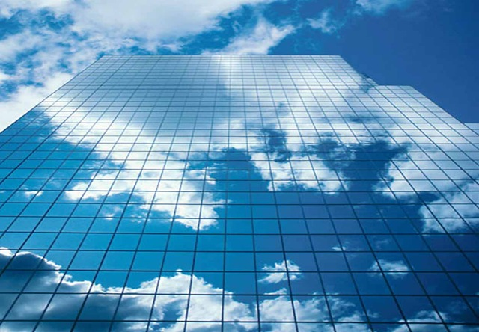
Introduction : Business and IT perspective, Cloud and virtualization, Cloud services requirements, cloud and dynamic infrastructure, cloud computing characteristics, cloud adoption.

Slide 21
Reasons for adopting cloud:
Massive, Web-scale infrastructure
Dynamic allocation, scaling
Pay per use
No-long commitments
OS / Application independent
No hardware or software to install

Slide 22
Benefits to business / IT
Innovative projects can lead to new revenue
No barrier
Effective service model
Deliver service in less cost
Deploy applications as and when required

Slide 23
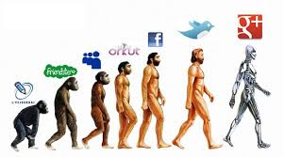

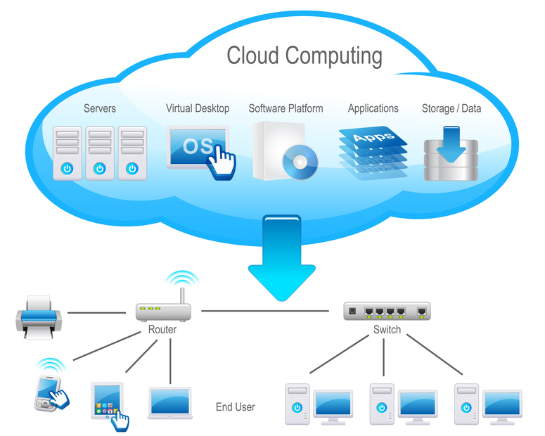
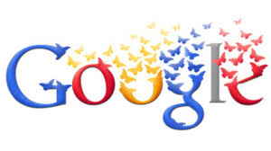
1.1 Business and IT Perspective
The impressive success of companies such as
Google, Facebook with the use of Cloud Computing has made companies to think towards making similar services and user experience to their users - employees, partners and customers.

Slide 24
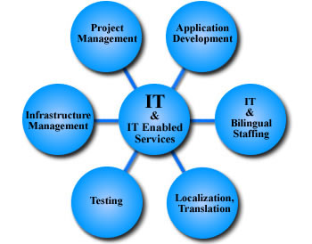

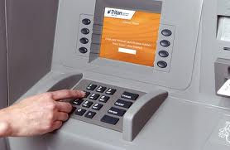
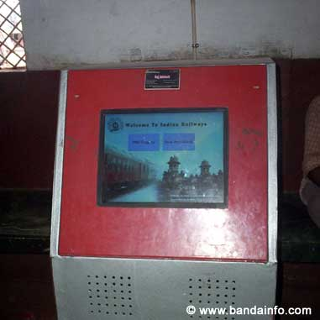
1.1 Business and IT Perspective
Delivering IT -enabled services
via internet, that are built for the
end-users to be in control is
what has come to be called as "Cloud Computing". Ex: Gmail.
Self-Service is an important characteristic of Cloud Computing.
Ex -1: Bank ATM -
2- PNR Status Check in Railway Stations.

Slide 25
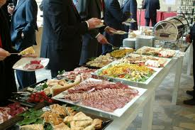
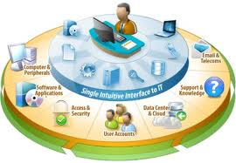
Self Service - Illustration

Slide 26
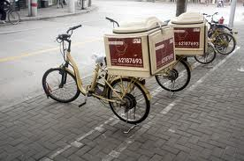
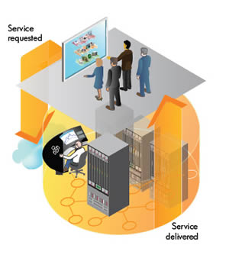
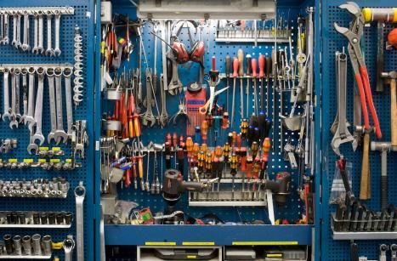

1.1 Business and IT Perspective
Cloud Computing is an emerging consumption and delivery model
that enables provisioning of standardised business and computing services through a shared infrastructure, where-in end user is enabled to control the interaction in-order to accomplish the business task.

Slide 27
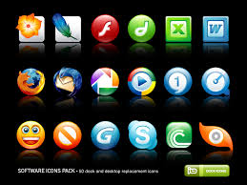
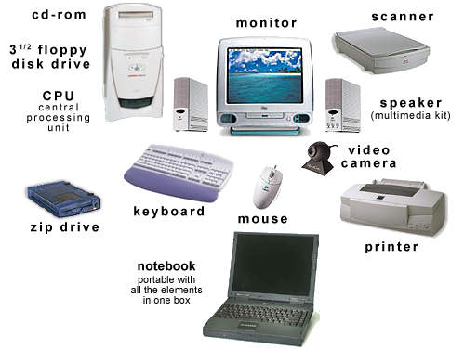
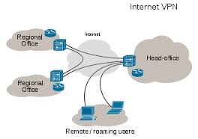
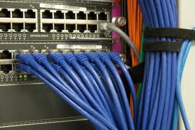
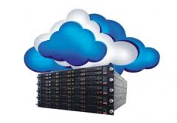
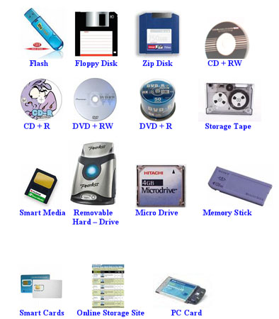
1.1 Business and IT Perspective
Computing resources such as hardware , software
networks - ,storage,
services
and interfaces are no longer confined within the four walls of the enterprise.

Slide 28
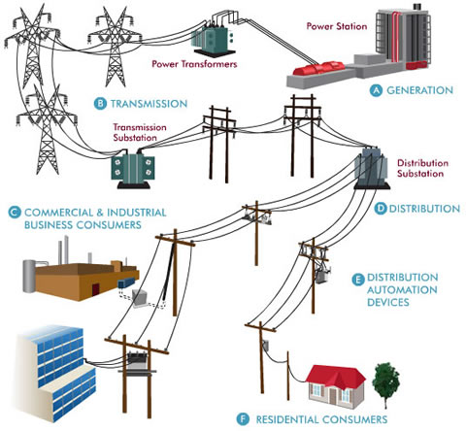
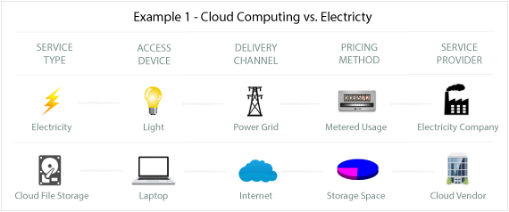
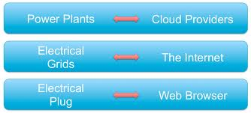
1.1 Business and IT Perspective
Essentially everything needed from a computing
resources perspective is provisioned by the cloud ,
much like electrical power grid -

Slide 29
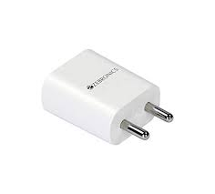
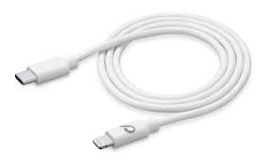
Assume!!!!
If you want to charge your mobile phone, what all u need??
1 charger 1 usb cable
If you want to charge 5 mobile phone???
5 chargers 5 usb cable

Slide 30
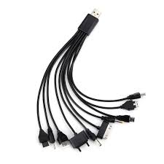
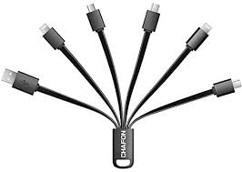
Thanks to china!!!

Slide 31
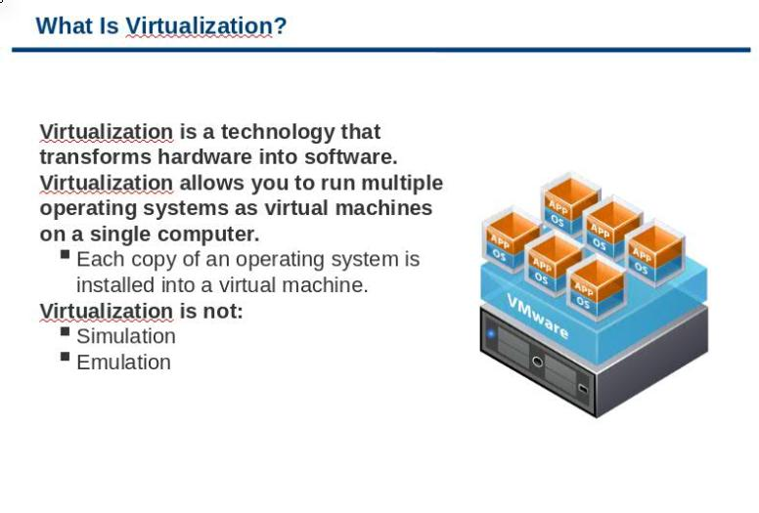
Virtulization

Slide 32
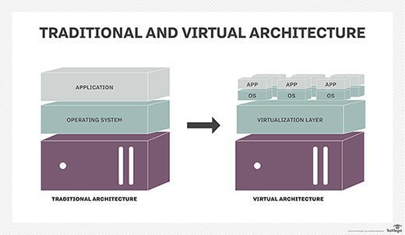

Slide 33
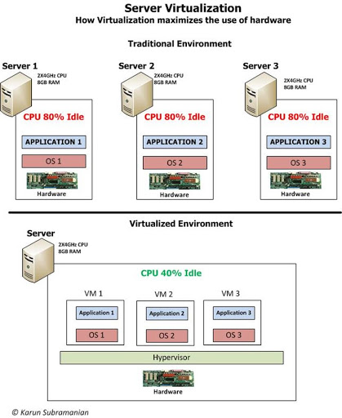

Slide 34
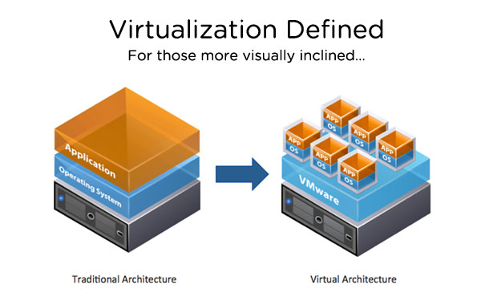
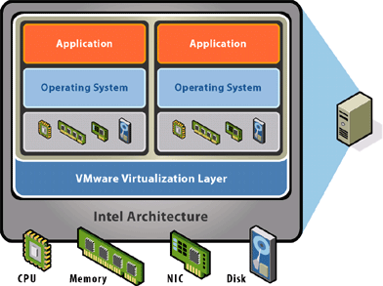
1.2 Cloud and Virtualization
Virtualization has a longer history of more than 30 years.
Virtualization is the
foundation for all that is
possible through cloud -

Slide 35
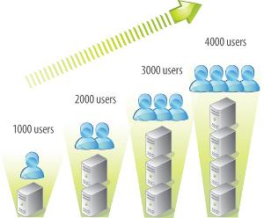




1.2 Cloud and Virtualization
Scalability -
, Automation -
, Standardised services -
, are possible only because of
underlying Virtualization.

Slide 36



1.2 Cloud and Virtualization
Cloud Computing promises :
self-service -
self-provisioning -
rapid provisioning
(web-based - takes minutes) -
To be able to realise these in practise virtualization must be implemented.

Slide 37



1.2 Cloud and Virtualization
Virtualization gives rise to cost savings -
and improve services -

Slide 38




1.2 Cloud and Virtualization
1.2 Cloud and Virtualization
1.2 Cloud and Virtualization
1.2 Cloud and Virtualization

Slide 39
1.2 Cloud and Virtualization
Results of Virtualization:
Server/Storage - pooled
Automation using self -service portal
Standardization thorough catalogue

Slide 40



1.2 Cloud and Virtualization
Results of Virtualization:
Server/Storage - IT resources such as storage, network, application are pooled
to enable elastic scaling -

Slide 41



1.2 Cloud and Virtualization
Results of Virtualization:
Automation using self -service portal

Slide 42

1.2 Cloud and Virtualization
Results of Virtualization:
Standardization thorough catalogue -

Slide 43

1.3 Cloud Service Requirements
A proven service management system to provide visibility, control and automation across IT.
Services to help accelerate standardization, rapid client payback on investment.

Slide 44



1.4 Cloud and Dynamic Infrastructure
Cloud Computing is Dynamic in Nature
It allows clients to access standardised IT resources to deploy new applications, services or computing resources -
rapidly without reengineering their entire infrastructure, thus making it dynamic.

Slide 45







1.3 Cloud Service Requirements
Cloud Dynamic Infrastructure provides the following features:
Service Management
Asset Management
Virtualization and Consolidation
Information Infrastructure
Energy Efficiency
Security
Resilience

Slide 46


Cloud Computing Characteristics - Primary
Cloud computing uses commodity based hardware as its base - replace h/w without affecting the cloud.
It uses commodity based software container system - Ex: service should
be able to be moved from one
cloud provider to any other cloud
provider with no effect on the
service.

Slide 47






1.5 Cloud Computing Characteristics - Secondary
Virtualization
Abstraction layer for h/w, s/w and configuration systems
Multi-tenant system
Pay as you go with no-lock in
Privacy and Security of Data
Flexible migration and restart capabilities
Autonomic Computing - Automated restarts, automated resource expansion and contraction
Dynamic Scaling - Horizontal / Vertical

Slide 48

Cloud Computing - Essential Characteristics

Slide 49

Cloud Computing - Essential Characteristics

Slide 50




1.6 Cloud Adoption
Business function that suits cloud adoption can be low-priority business applications :
Business intelligence against large database
Partner facing project sites
Low priority services

Slide 51



1.6 Cloud Adoption - cntd
Cloud favours traditional web applications and interactive applications that comprise two or more data sources and services
services with low availability requirements and short life spans
Enterprise marketing campaigns need quick delivery of services and can just be quickly be switched off.

Slide 52





1.6 Cloud Adoption - Cntd
Helpful for high volume, low cost analytics and disaster recovery scenarios, business continuity, backup/recovery-based implementation.
ghdgh
jjh
One time batch processing with limited security requirements
Record retention

Slide 53




1.6 Cloud Adoption - Cntd
Media distribution
Mature packaged offerings - email
Collaboration infrastructure and collaborative business networks

Slide 54





1.6 Cloud Adoption - cntd (based on technical characteristics)
Applications that are modular and loosely coupled
Isolated workloads
Single Virtual Appliance Workload
Software Development and Testing
Pre-Production Systems
R & D Projects
Prototyping to test new services and applications
Design models and applications that scale horizontally on small servers

Slide 55



1.6 Cloud Adoption - cntd
Applications that need significantly different levels of infrastructure throughout the day
Applications that are used solely during business day
Applications with seasonal demand
Applications that need different levels of infrastructure throughout the month

Slide 56



1.6 Cloud Adoption - cntd
Applications where demand is unknown in advance - web start -up will need to support a spike in demand when it becomes popular, followed by reduction once some of visitors turn away.

Slide 57




Cloud Adoption - Not Suitable
Mission critical and core business applications, transaction processing and application that depend on sensitive data normally restricted to organization requiring high level of accountability and auditability
Applications that run 24/7/365 with steady demand

Slide 58



Cloud Adoption - Not Suitable
Applications that consume significant amount of memory, that demand large memory cache, database, data-sets
Applications that take full advantages of multiple cores - parallel processing - that benefit from many cores on a single server are not good for cloud deployment.

Slide 59



Cloud Adoption - Not Suitable - cntd
Applications that require high -performance file system I/O , needing bandwidth, inter-server communications - highly distributed applications,
Cloud does not work well with applications that scale vertically on single server, and applications dependent on third party software, which does not have virtualization or cloud aware licensing strategy.

Slide 60

Summary

Slide 61

Summary

Slide 62



Slide 63


Slide 64
Acknowledgements
1) Dr. Kumar Saurabh - Contents
2) Prof. Ravindra Dastikop's Blog - http://cloudcomputing4postgraduates.blogspot.in/
3) All images are from - Google Images Service

Slide 65


